Slide 1




Using Views

Slide 2

Using Views
Here are some other common uses:
To reuse SQL statements.
To simplify complex SQL operations. After the query is written, it can be reused easily, without you having to know the details of the underlying query itself.
To expose parts of a table instead of complete tables.
To secure data. Users can be given access to specific subsets of tables instead of to entire tables.

Slide 3
Using Views
CREATE VIEW productcustomers AS
SELECT cust_name, cust_contact, prod_id
FROM customers, orders, orderitems
WHERE customers.cust_id = orders.cust_id
AND orderitems.order_num = orders.order_num;

Slide 4
Using Views to Reformat Retrieved Data
CREATE VIEW vendorlocations AS
SELECT RTrim(vend_name) + ‘ (‘ + RTrim(vend_country) + ‘)’ AS vend_title FROM vendors;
CREATE VIEW orderitemsexpanded AS
SELECT order_num, prod_id, quantity, item_price, quantity*item_price AS expanded_price FROM orderitems;

Slide 5
Updating Views
As a rule, yes, views are updateable (that is, you can use INSERT, UPDATE, and DELETE on them). Updating a view updates the underlying table (the view, you will recall, has no data of its own); if you add or remove rows from a view, you are actually adding them to or removing them from the underlying table.

Slide 6
Updating Views
In practice, this means that if any of the following are used, you’ll not be able to update the view:
Multiple base tables
Grouping (using GROUP BY and HAVING)
Joins
Subqueries
Unions
DISTINCT
Derived (calculated) columns

Slide 7
Programming with T-SQL
T-SQL is not a general-purpose programming language, but it does support some basic programming ideas and constructs that can be used within data manipulation processes. These are generally not used when working with simple SQL statements, but are often used when working with stored procedures.

Slide 8
Using Variables
A variable is a named object that stores values. Although variable use and capabilities vary from one programming language to the next, the basic ability to define variables and store values in them for subsequent use is pretty universal.
DECLARE @age INT;
DECLARE @firstName CHAR(20), @lastName CHAR(20);

Slide 9
Using Variables
DECLARE @age INT;
DECLARE @firstName CHAR(20), @lastName CHAR(20);
SET @lastName=’Forta’;
SET @firstName=’Ben’;
SET @age=21;
You can also use SELECT to assign values to variables, as shown here:
Input ▼
SELECT @age=21;

Slide 10
Viewing Variable Contents
DECLARE @age INT;
DECLARE @firstName CHAR(20), @lastName CHAR(20);
SET @lastName=’Forta’;
SET @firstName=’Ben’;
SET @age=21;
PRINT @lastName + ‘, ‘ + @firstName;
PRINT @age;

Slide 11
Using Conditional Processing
-- Define variables
DECLARE @open BIT
-- Open for business today?
IF DatePart(dw, GetDate()) = 1
SET @open = 0
ELSE
SET @open = 1
-- Output
SELECT @open AS OpenForBusiness

Slide 12
Grouping Statements
-- Define variables
DECLARE @dow INT
DECLARE @open BIT, @process BIT
-- Get the day of week
SET @dow = DatePart(dw, GetDate());
-- Open for business today?
IF @dow = 1 OR @dow = 7
SET @open = 0
SET @process = 0
ELSE
SET @open = 1
SET @process = 1

Slide 13
Using Looping
DECLARE @counter INT
SET @counter=1
WHILE @counter <= 10
BEGIN
PRINT @counter
SET @counter=@counter+1
END

Slide 14
Stored Procedures
A stored procedure is a routine that allows you to reuse a code module in a SQL Server context. Anything you can do with Transact-SQL or with a .NET language, you can use in a stored procedure. Some limitations exist, however. For example, you can use only .NET code that is relevant to the SQL Server context that you’re executing in.

Slide 15
Stored Procedures
To run a stored procedure, use the EXECUTE statement. To run a stored procedure named spGetCustomers, use this command:
EXECUTE spGetCustomers
You can use EXEC as an abbreviation for EXECUTE, so typing
EXEC spGetCustomers
also executes the spGetCustomers stored procedure.

Slide 16
Stored Procedures
A stored procedure offers the following advantages compared with storing Transact-SQL code on client machines:
Stored procedures are registered at the server.
Stored procedures can have permissions assigned to them.
Stored procedures can have certificates associated with them.
Stored procedures can reduce network traffic.

Slide 17
Creating a Stored Procedure
You create a stored procedure by using the CREATE PROCEDURE statement.
The general form of a CREATE PROCEDURE statement is as follows:
CREATE PROCEDURE <stored_procedure_name>
AS
<Transact-SQL statement(s)>

Slide 18
Creating a Stored Procedure
You can use PROC as an abbreviation for PROCEDURE, as in:
CREATE PROC <stored_procedure_name>
AS
<Transact-SQL statement(s)>

Slide 19
Creating a Stored Procedure
To enable successful execution of the CREATE PROCEDURE statement, add a GO keyword, which signals the end of a batch. Therefore in the following commands, the CREATE PROCEDURE statement is the first statement in a new batch that follows the GO keyword.
USE Northwind
GO
CREATE PROCEDURE spGetCustomers
AS
SELECT CompanyName, City, Region, Country
FROM Northwind.dbo.Customers

Slide 20
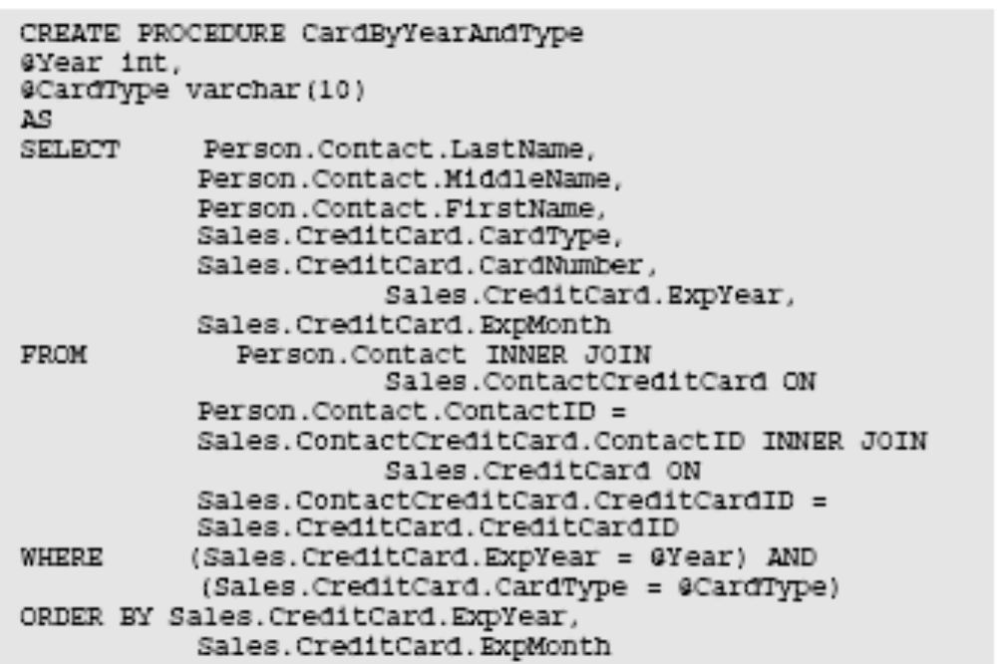
Parameters with Stored Procedures

Slide 21
Parameters with Stored Procedures
The following command executes the stored procedure so that Vista cards expiring in 2008 are returned:
EXEC CardByYearAndType @Year = 2008, @CardType = ‘Vista’

Slide 22
Building Intelligent Stored Procedures
-- Name: ordertotal
-- Parameters: @order_num = order number
-- @taxable = 0 if not taxable, 1 if taxable
-- @order_total = order total variable
CREATE PROCEDURE ordertotal
@order_num INT,
@taxable BIT,
@order_total MONEY OUTPUT
AS
BEGIN

Slide 23
Building Intelligent Stored Procedures
-- Declare variable for total
DECLARE @total MONEY;
-- Declare tax percentage
DECLARE @taxrate INT;
-- Set tax rate (adjust as needed)
SET @taxrate = 6;
-- Get the order total
SELECT @total = Sum(item_price*quantity)
FROM orderitems
WHERE order_num = @order_num

Slide 24
Building Intelligent Stored Procedures
-- Is this taxable?
IF @taxable = 1
-- Yes, so add taxrate to the total
SET @total=@total+(@total/100*@taxrate);
-- And finally, save to output variable
SELECT @order_total = @total;
END;

Slide 25
Building Intelligent Stored Procedures
DECLARE @order_total MONEY
EXECUTE ordertotal 20005, 0, @order_total OUTPUT SELECT @order_total
DECLARE @order_total MONEY
EXECUTE ordertotal 20005, 1, @order_total OUTPUT
SELECT @order_total

